Slide 1
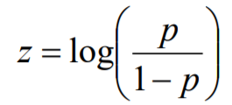

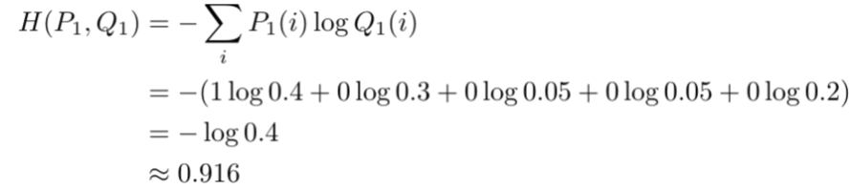


Input Layer
Hidden Layer
Hidden Layer
Output Layer
Weighted Connection
i1
w1
Logits
(-inf, inf)
h1
w’1
w2
Weighted Connection
Mapping probability
i1
w7
Odds
(0, inf)
Pi/(1-Pi)
w3
w8
w9
w’2
h2
w’’1
i1
h1
w'1
mapping
softmax
w4
w10
Activation
function
out
Probabilities
(0,1)
w13
w'2
Pi
w11
w14
w’’2
i1
w15
w’3
w'3
h2
w5
w12
h1
tf.nn.softmax_cross_entropy_with_logits_v2()
w16
w'4
mapping
i1
w17
w’4
w6
w18
h1
Gradient Descent
b3
Batch Gradient Descent
Cross Entropy
(0,1)
i1
b2
b2
b1
b1
Stochastic Gradient Descent
Mini batch Gradient Descent
Calculate
Error
Loss function
Adam
Momentum
Adagrad
b
b
…
Mean Square Error
Optimizer
Back Propagation
on errors

Slide 2
y
tf.placeholder
[None, n_classes]
Tensorflow parameters pre-defined
Weight (w1)
probability
Biases
(b1)
Biases
(b2)
Biases
(out)
Input Layer
Hidden Layer 1
Hidden Layer 2
batch_y
0
0
1
0
0
0
0
0
0
0
n_input = 784
Weight (w2)
softmax
0
0
0
0
0
1
0
0
0
0
batch_x
…
1
batch_size
0
0
0
0
0
0
0
0
0
…
0
0
1
0
0
0
0
0
0
0
n_classes = 10
pred
Multiplayer_perceptron(x, weights, biases)
x
tf.placeholder
[None, n_input]
batch_y
batch_x
n_hidden_2
=256
batch_size
n_hidden_1
=256
…
Legend
Red: parameter should be predefined.
Blue: Value of parameter.
batch_y
Orange: Type of parameter.
Black: Object.
batch_x
n_hidden_2
n_classes
batch_size
n_hidden_2*
n_classes
n_input *
n_hidden_1
…
n_hidden_1
n_hidden_1* n_hidden_2
…
…
…
n_samples = 55000
epoch = 15
Weights: dict
{‘w1’: tf.Variables [n_input, n_hidden_1]
‘w2’: tf.Variables [n_hidden_1, n_hidden_2]
‘w3’: tf.Variables [n_hidden_2, n_classes] }
biases: dict
{‘b1’: tf.Variables [n_hidden_1]
‘b2’: tf.Variables [n_hidden_2]
‘out’: tf.Variables [n_classes]}

Slide 3
train
batch
batch
train
batch
train
N epochs

Slide 4
